Slide 1
TESTING
Jest
Installation
Create the first Jest test
Matchers
Setup & Teardown
Group tests using describe()
Testing asynchronous code
Callbacks
Promises
Async/await
Mocking
Snapshot testing
Testing React components

Slide 2
Jest is a library for testing JavaScript code.
it’s fast
it can perform snapshot testing
it’s opinionated, and provides everything out of the box without requiring you to make choices
Notes:
It’s an open source project maintained by Facebook, and it’s especially well suited for React code testing, although not limited to that: it can test any JavaScript code. Its strengths are: it’s fast, it can perform snapshot testing, it’s opinionated, and provides everything out of the box without requiring you to make choices

Slide 3
Jest is a tool very similar to Mocha, although they have differences:
Mocha is less opinionated, while Jest has a certain set of conventions
Mocha requires more configuration, while Jest works usually out of the box, thanks to being opinionated
Mocha is older and more established, with more tooling integrations
Notes:
In my opinion the biggest feature of Jest is it’s an out of the box solution that works without having to interact with other testing libraries to perform its job.

Slide 4
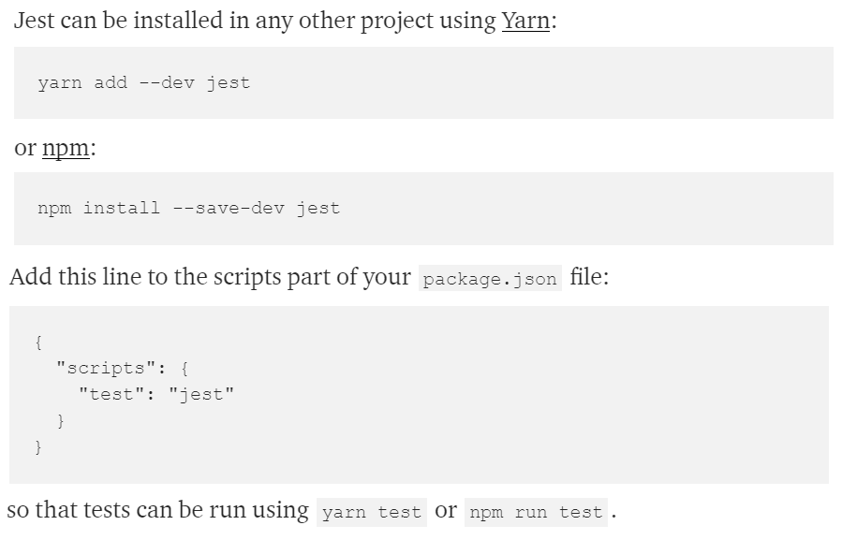
Installation
Notes:
Jest is automatically installed in create-react-app, so if you use that, you don’t need to install Jest.

Slide 5
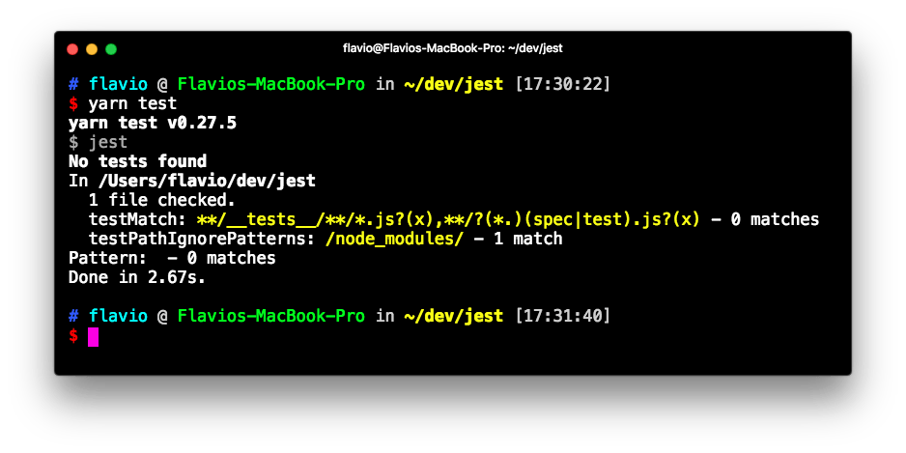
Create the first Jest test
Projects created with create-react-app have Jest installed and preconfigured out of the box
Run your tests by executing yarn test in your shell.

Slide 6
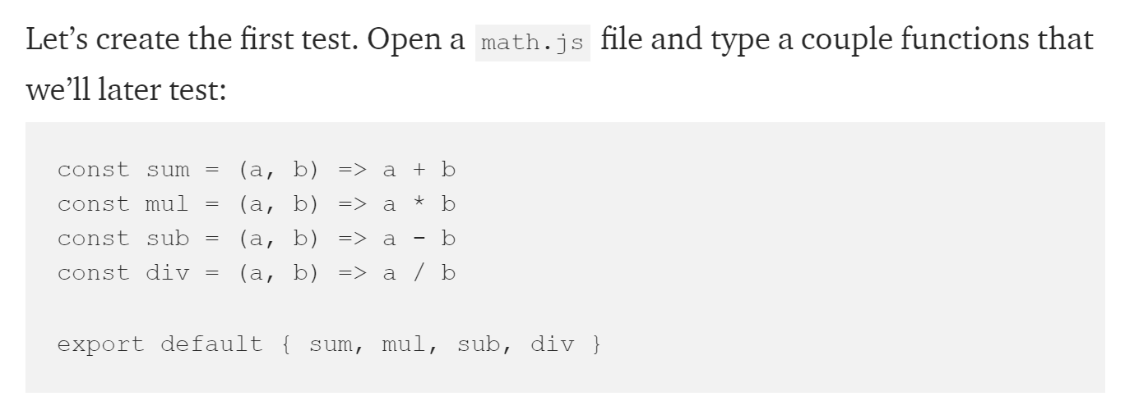
Let’s create the first test. Open a math.js file and type a couple functions that we’ll later test:

Slide 7
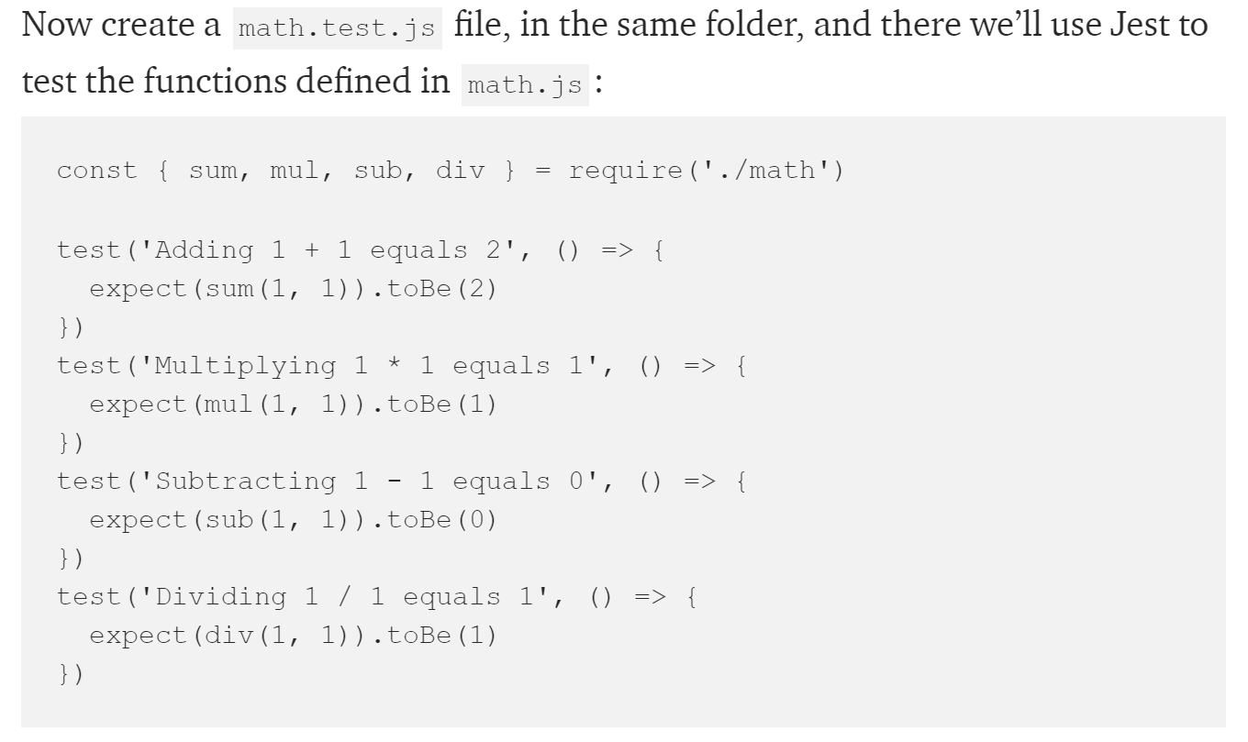

Slide 8
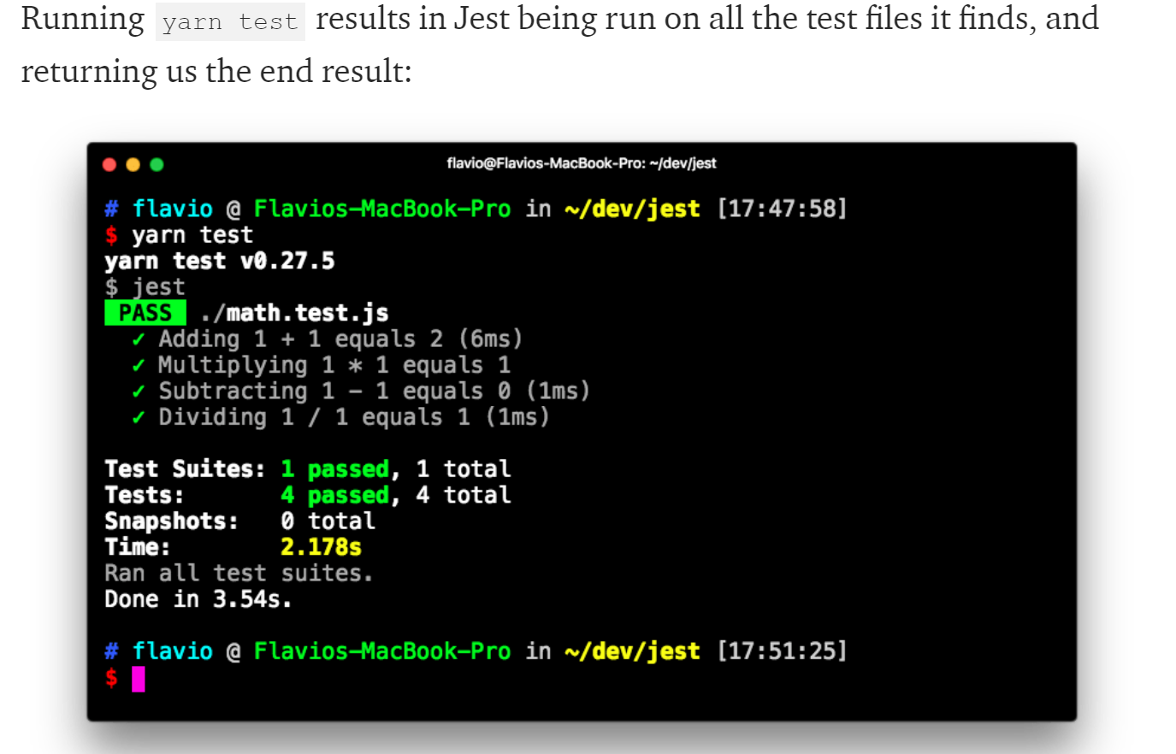

Slide 9
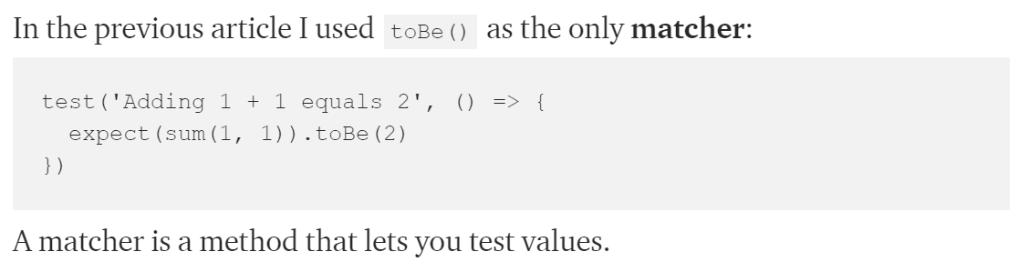
Matchers

Slide 10
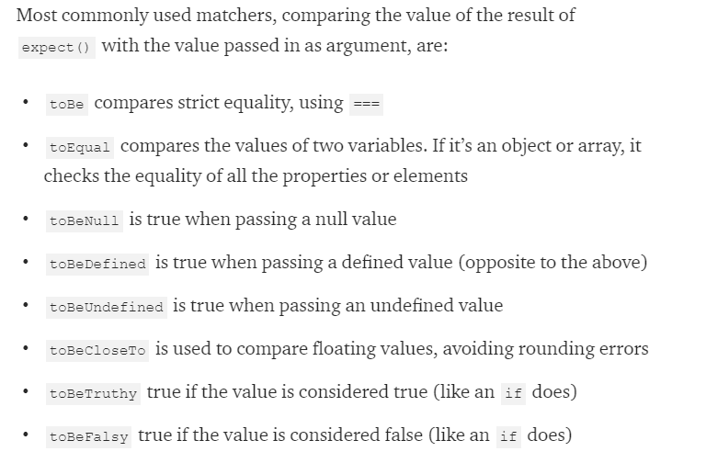

Slide 11
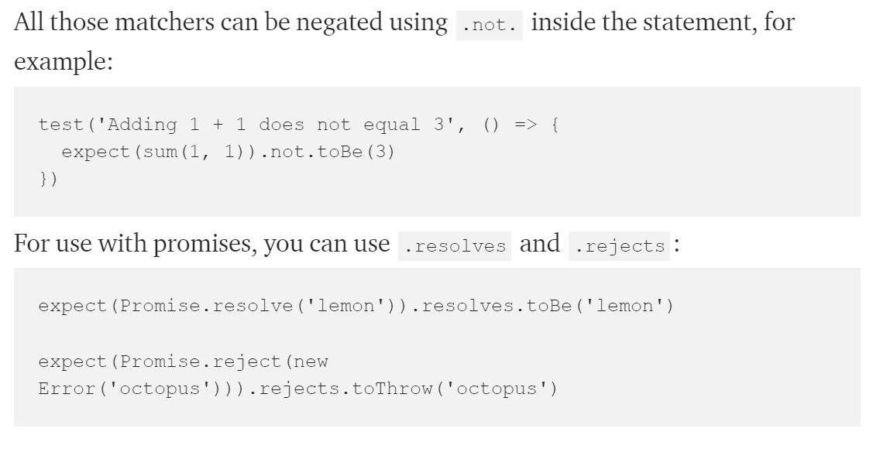

Slide 12
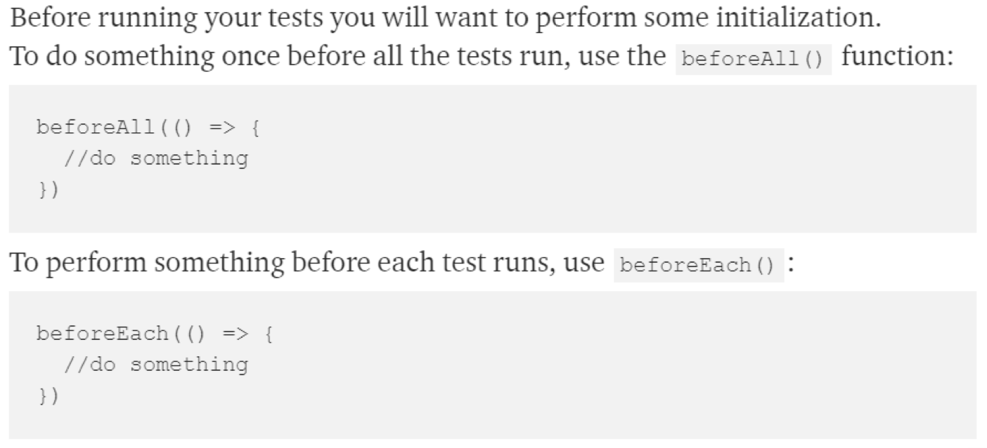
Setup & Teardown

Slide 13
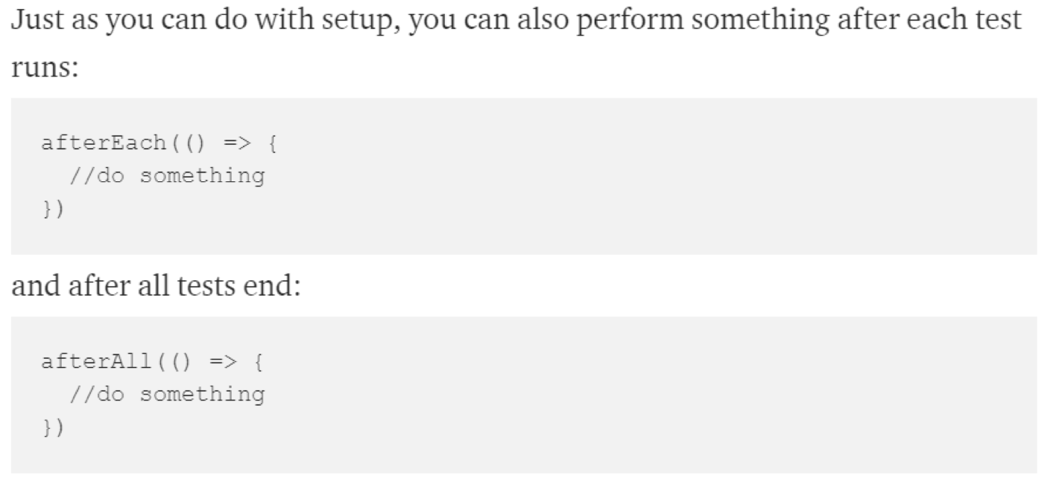

Slide 14
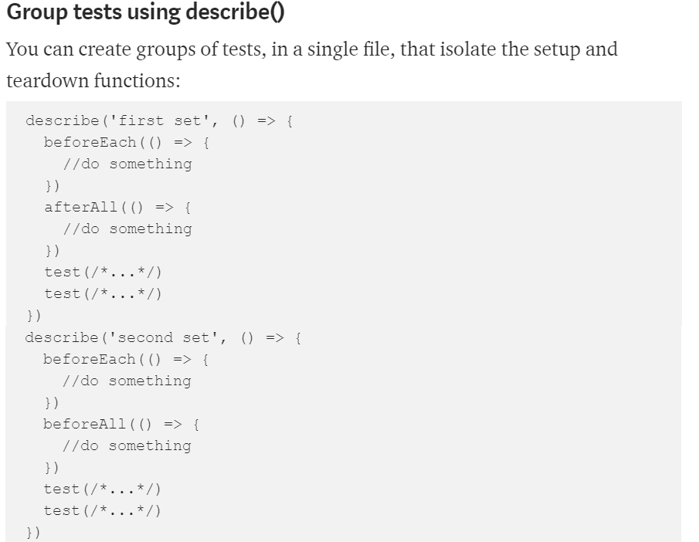

Slide 15
Testing asynchronous code
Callbacks
Promises
Async/await
Notes:
Asynchronous code in modern JavaScript can have basically 2 forms: callbacks and promises. On top of promises we can use async/await.

Slide 16
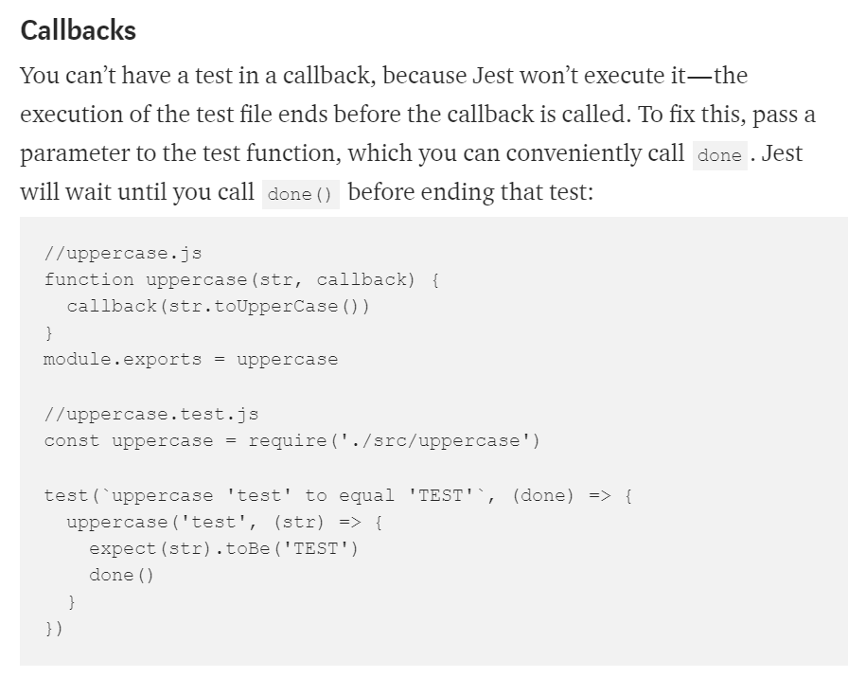

Slide 17
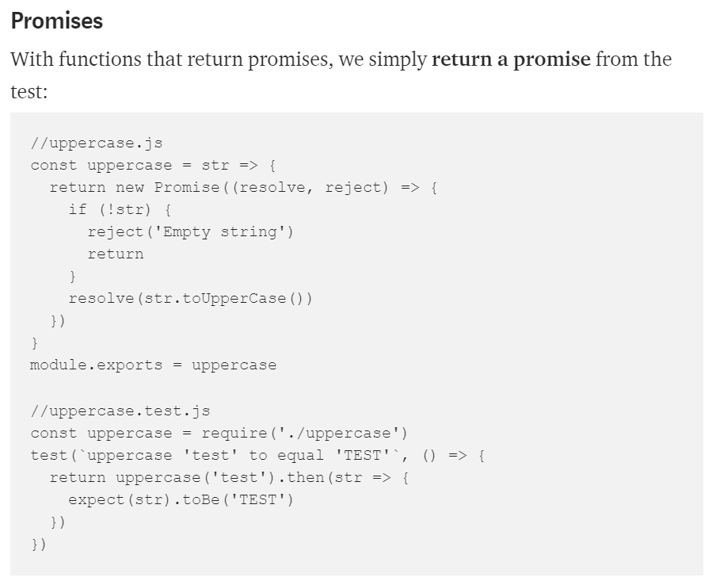

Slide 18
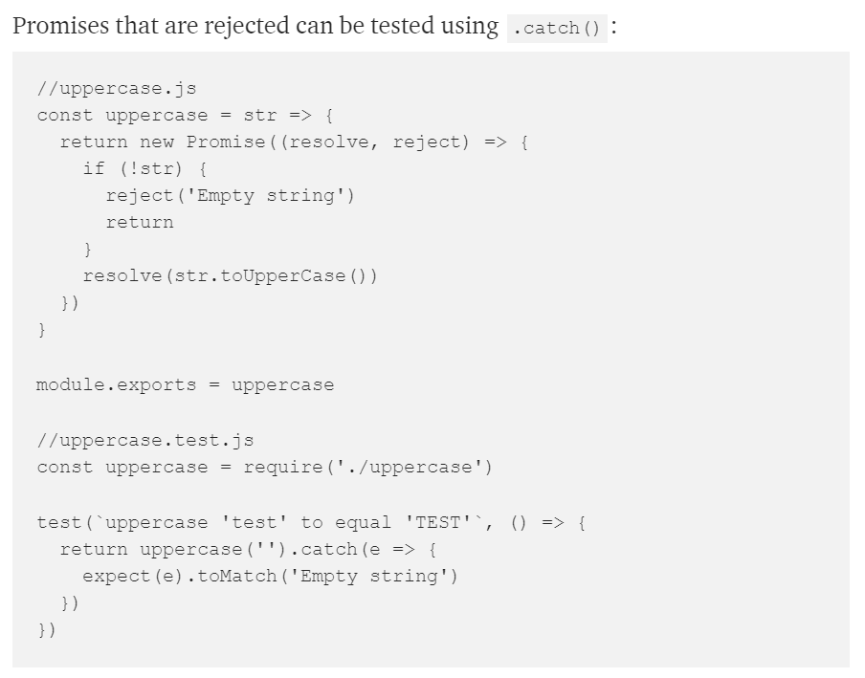

Slide 19
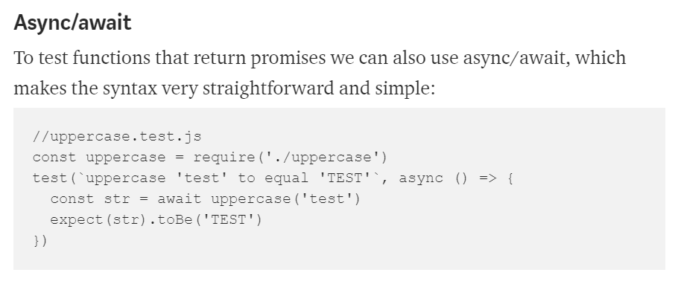

Slide 20
Mocking
In testing, mocking allows you to test functionality that depends on:
Database
Network requests
access to Files
any External system
Notes:
so that:
your tests run faster, giving a quick turnaround time during development
your tests are independent of network conditions, or the state of the database
your tests do not pollute any data storage because they do not touch the database
any change done in a test does not change the state for subsequent tests, and re-running the test suite should start from a known and reproducible starting point
you don’t have to worry about rate limiting on API calls and network requests
Mocking is useful when you want to avoid side effects (e.g. writing to a database) or you want to skip slow portions of code (like network access), and also avoids implications with running your tests multiple times (e.g. imagine a function that sends an email or calls a rate-limited API).
Even more important, if you are writing a Unit Test, you should test the functionality of a function in isolation, not with all its baggage of things it touches.

Slide 21
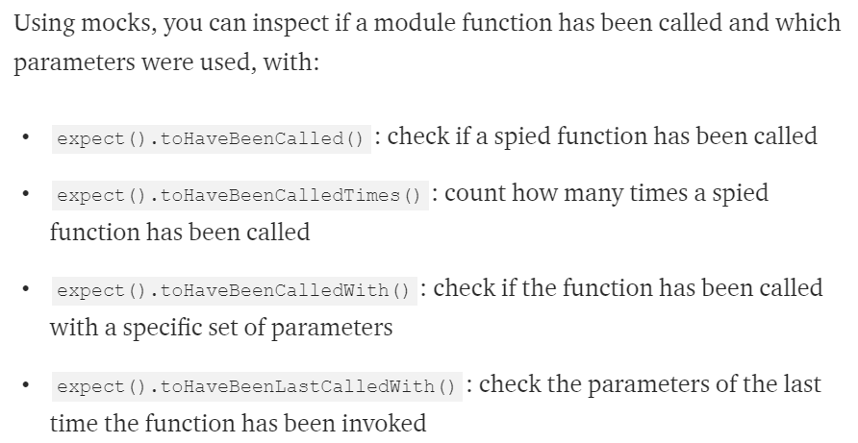

Slide 22
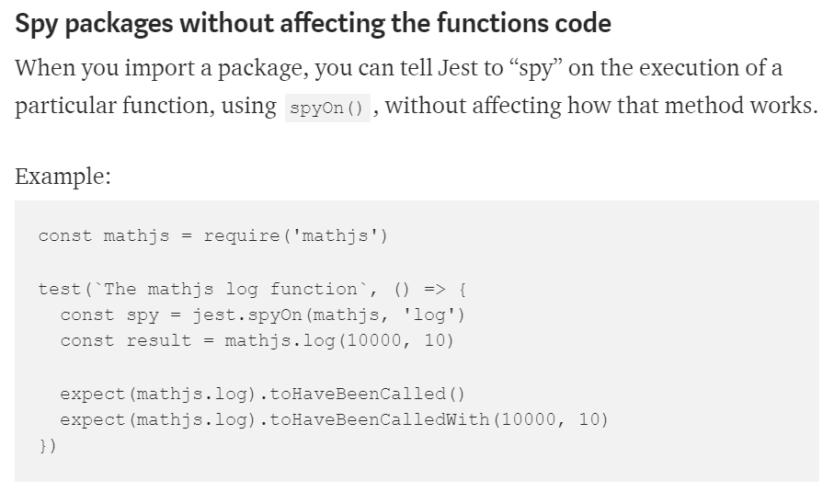

Slide 23
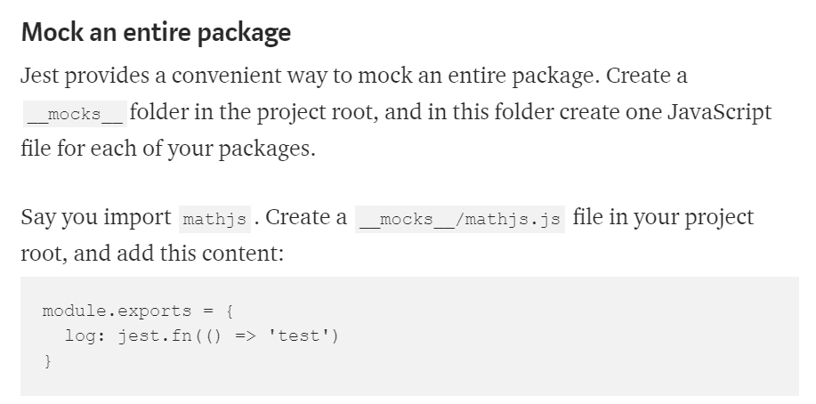

Slide 24
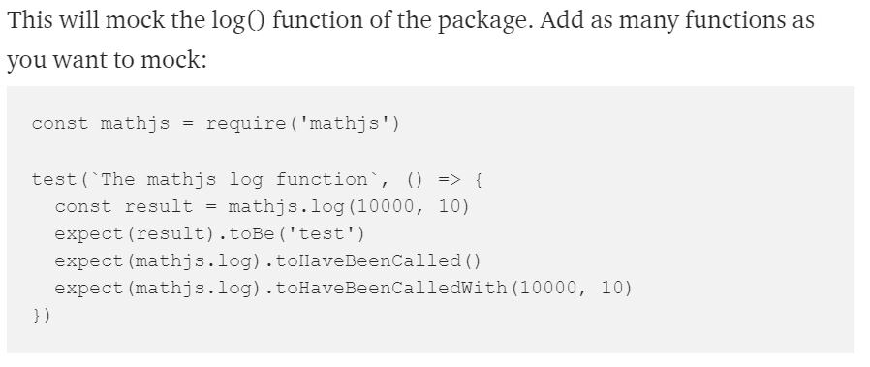

Slide 25
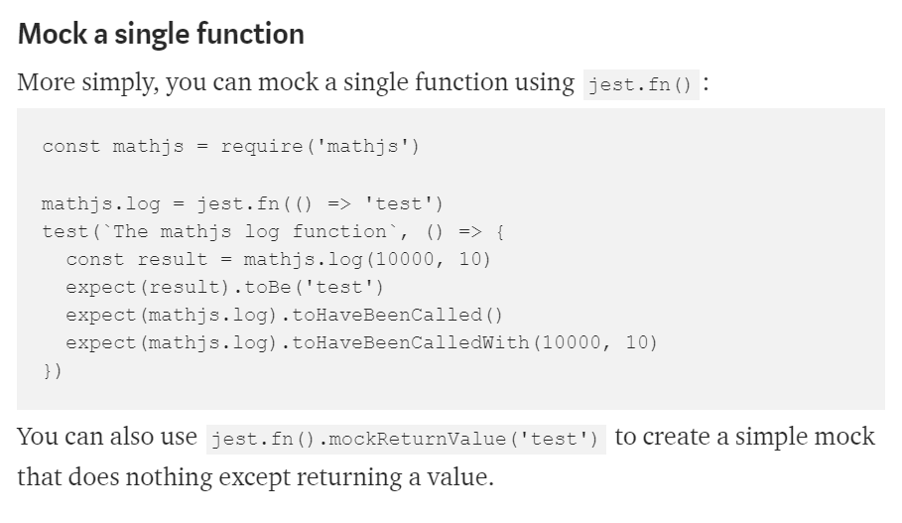

Slide 26
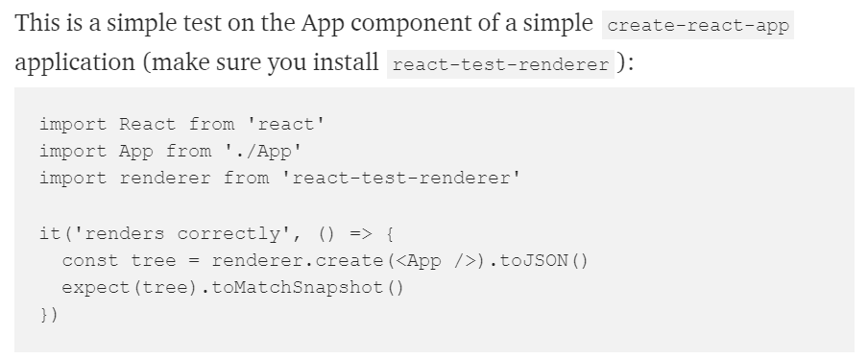
Snapshot testing
Notes:
Snapshot testing is a pretty cool feature offered by Jest. It can memorize how your UI components are rendered, and compare it to the current test, raising an error if there’s a mismatch.
the first time you run this test, Jest saves the snapshot to the __snapshots__folder. Here’s what App.test.js.snap contains:

Slide 27
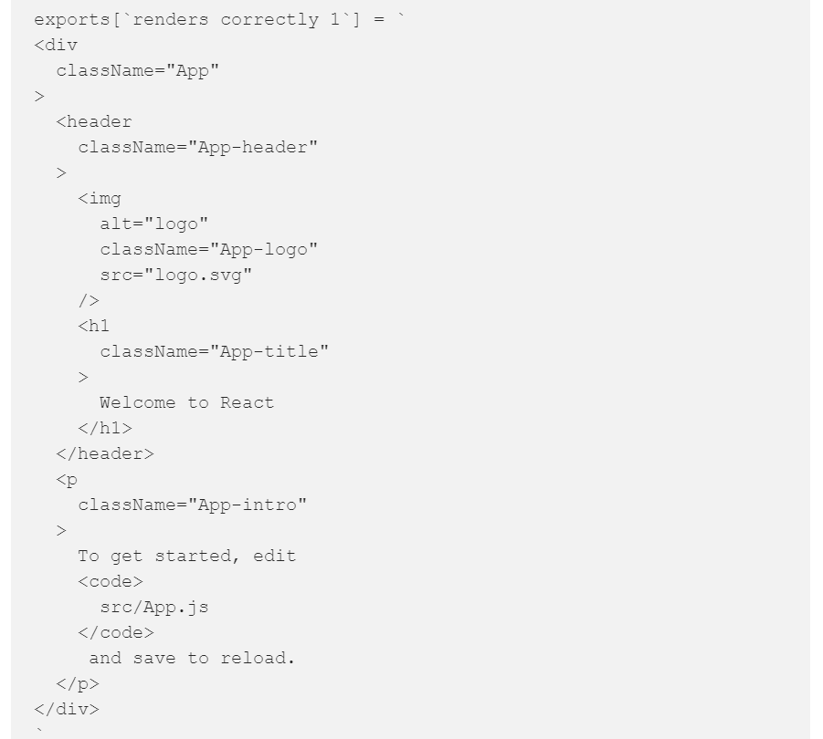
Here’s what App.test.js.snap contains:
Notes:
As you see it’s the code that the App component renders, nothing more.

Slide 28
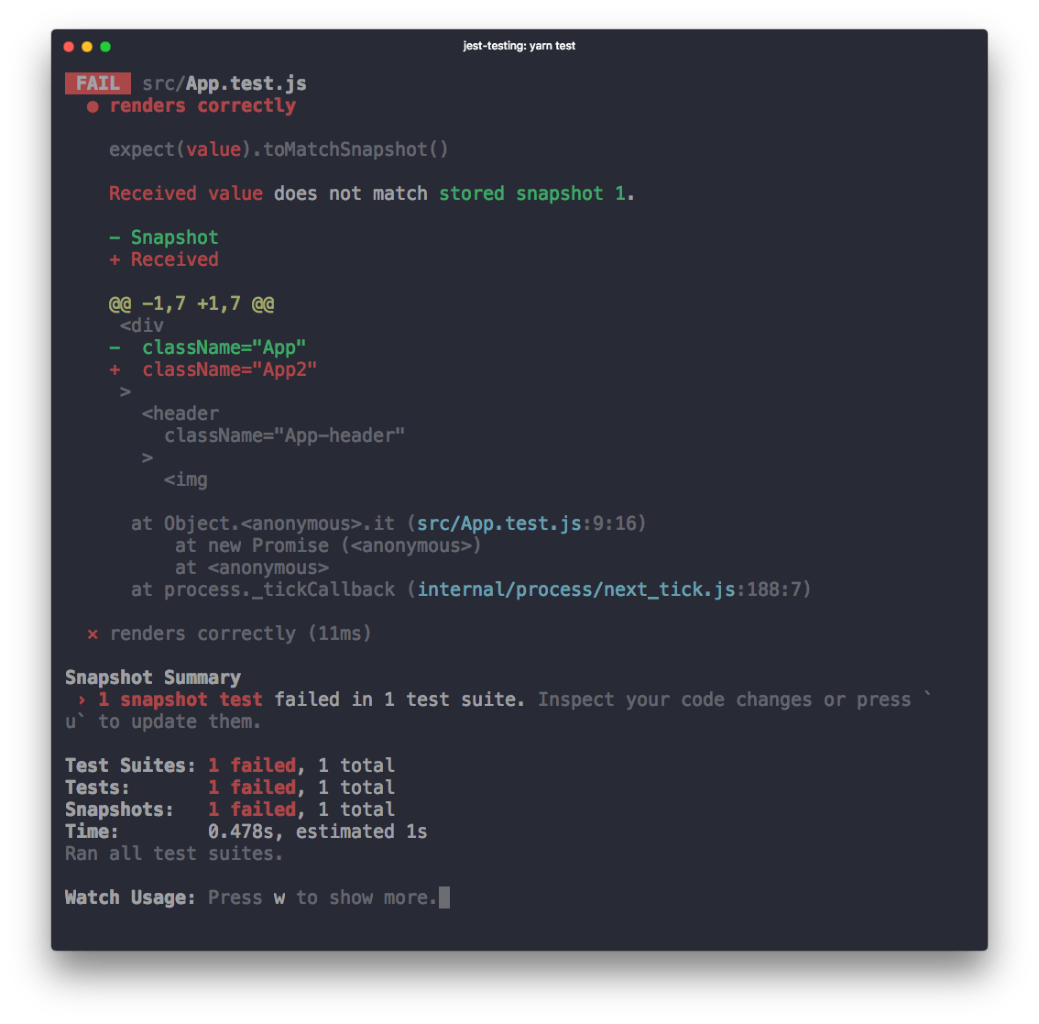
Notes:
The next time the test compares the output of <App /> to this. If App changes, you get an error:

Slide 29
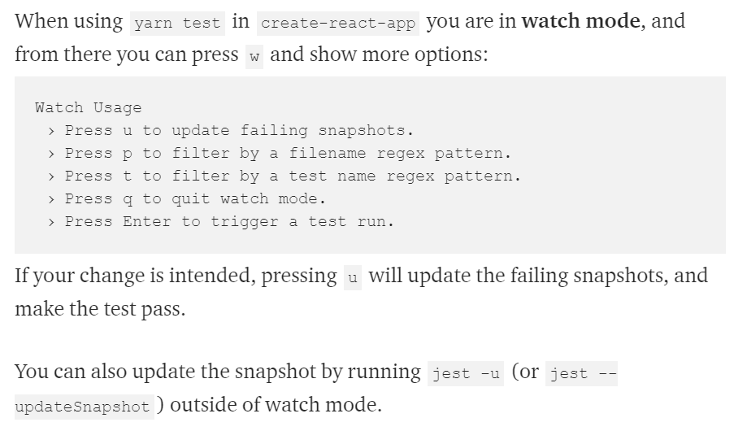

Slide 30
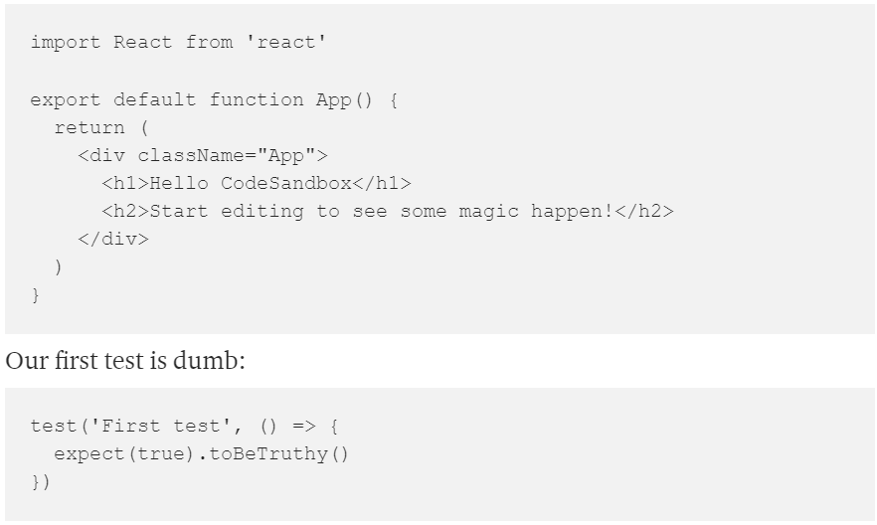
Testing React components
Notes:
The easiest way to start with testing React components is doing snapshot testing, a testing technique that lets you test components in isolation.
If you are familiar with testing software, it’s just like unit testing you do for classes: you test each component functionality.
I assume you created a React app with create-react-app, which already comes with Jest installed, the testing package we'll need.
Let’s start with a simple test. CodeSandbox is a great environment to try this out. Start with a React sandbox, and create an App.js component in a components folder, and add an App.test.js file.

Slide 31
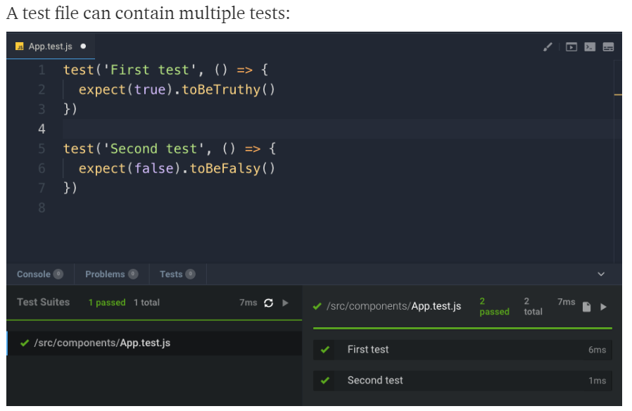
Notes:
Let’s do something a bit more useful now, to actually test a React component. We only have App now, which is not doing anything really useful, so let’s first set up the environment with a little application with more functionality: the counter app we built previously. If you skipped it, you can go back and read how we built it, but for easier reference I add it here again.

Slide 32
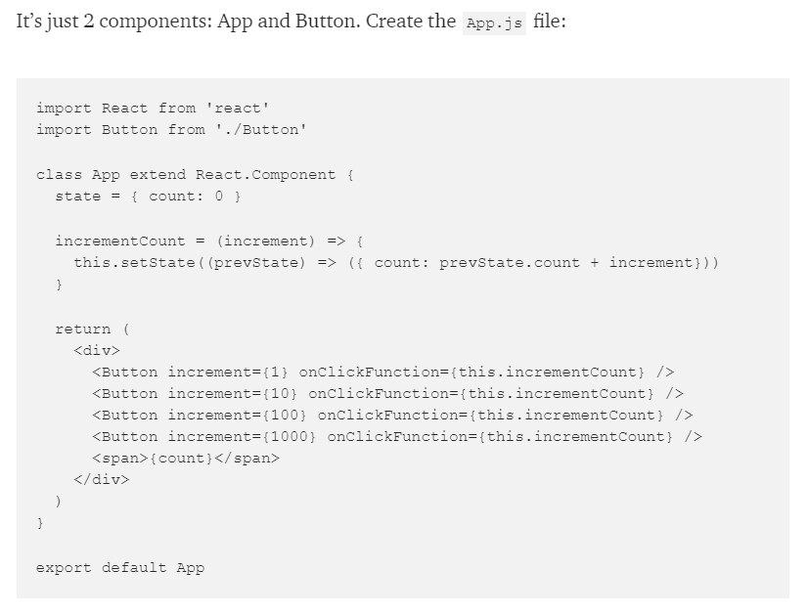

Slide 33
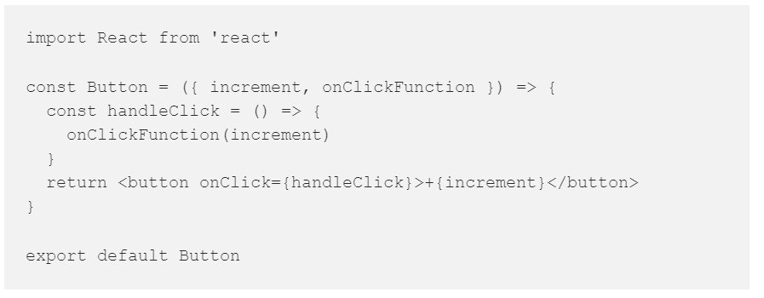
and the Button.js file:
Notes:
and the Button.js file:
We are going to use the react-testing-library, which is a great help as it allows us to inspect the output of every component and to apply events on them.

Slide 34
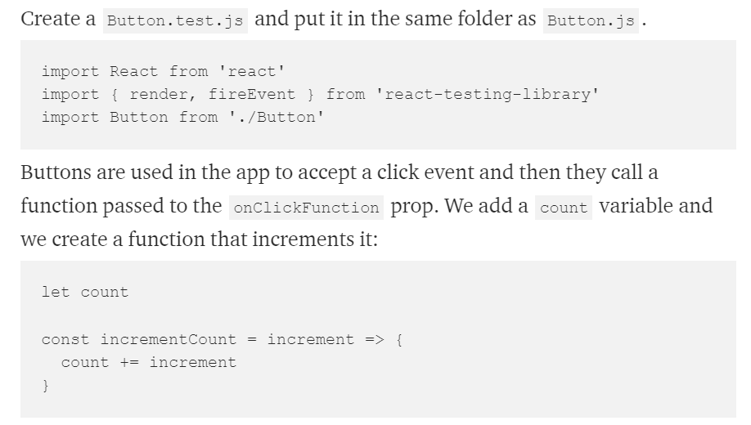
Notes:
Let’s test the Button component first.
We start by importing render and fireEvent from react-testing-library, two helpers. The first lets us render JSX. The second lets us emit events on a component.

Slide 35
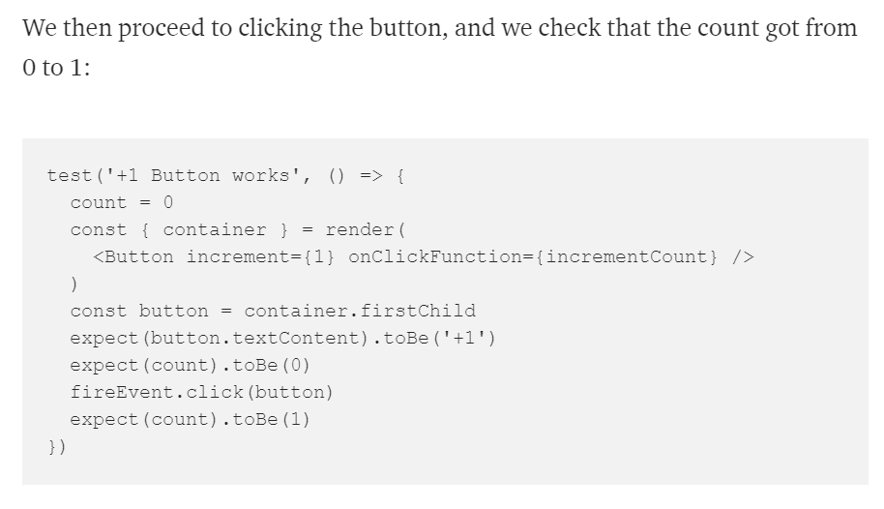
Notes:
Now off to the actual tests. We first initialize count to 0, and we render a +1Button component passing a 1 to increment and our incrementCountfunction to onClickFunction.
Then we get the content of the first child of the component, and we check it outputs +1.

Slide 36
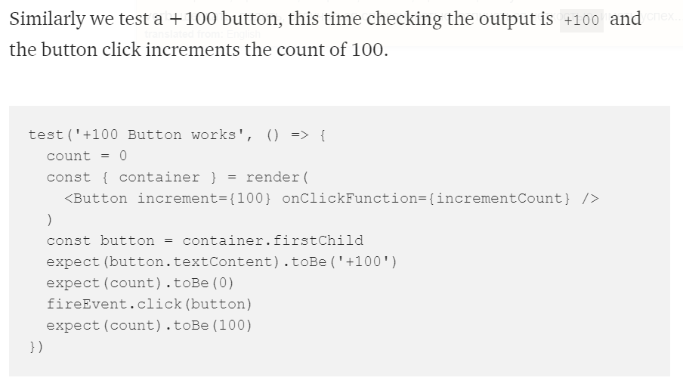

Slide 37
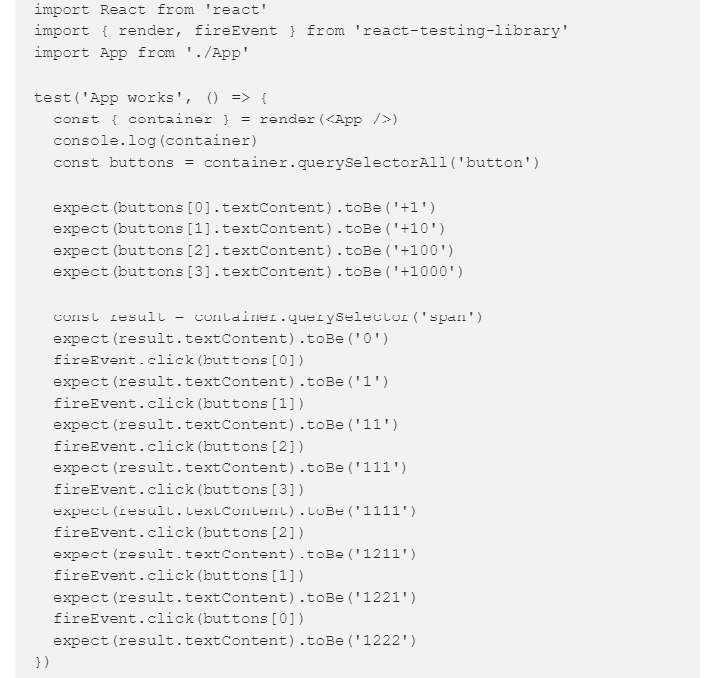
Notes:
Let’s test the App component now. It shows 4 buttons and the result in the page. We can inspect each button and see if the result increases when we click them, clicking multiple times as well:

